Slide 1





Building the Front Phase for Web
Notes:
Here trainer will introduce the course to the students. Also try to inform why we are starting with the HTML based on the web-based software application architecture
--------------------------------------------------------------------
Getting Familiar with HTML

Slide 2
Disclaimer
The content is curated from online/offline resources and used for educational purpose only

Slide 3

Learning Objective
You will learn in this lesson:
Different Web terminologies for understanding the web
HTTP concepts
Website v/s Web application
HTML Structure
Difference between HTML4 & HTML5
Formatting Tags
List
Link
Table
Form
Media
Graphics
Block Tags
Semantic Tags
Notes:
in this slide the trainer we'll inform the learning outcomes to the students that after completion of this course what actually the students are going to get to know or learn
--------------------------------------------------------------------------------
Learning Objectives
You will learn in this lesson:
HTML Structure
Difference between HTML4 & HTML5
Formatting Tags
List
Link
Table
Form
Media
Graphics
Block Tags
Semantic Tags

Slide 4

What is Internet?
Source:
https://sites.google.com/site/tassadar550/web-resource
Notes:
As you can see in this picture, whole world is globally connected to the internet.

Slide 5
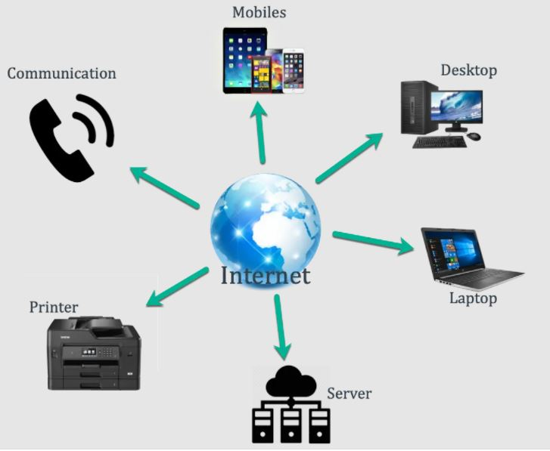
What is Internet?
Internet is a world-wide global system of interconnected computer networks.
Internet uses the standard Internet Protocol (TCP/IP).
Source:
https://img.webnots.com/2019/02/Overview-of-Internet.png
Notes:
What is Internet?
Internet is a world-wide global system of interconnected computer networks.
Internet uses the standard Internet Protocol (TCP/IP) to communicate between networks and devices. It is a network of networks that consists of private, public, academic, business, and government networks of local to global scope, linked by a broad array of electronic, wireless, and optical networking technologies. The Internet carries a vast range of information resources and services, such as the inter-linked hypertext documents and applications of the World Wide Web (WWW), electronic mail, telephony, and file sharing.
Reference - https://en.wikipedia.org/wiki/Internet

Slide 6


World Wide Web (WWW)
Notes:
The World Wide Web (WWW), commonly known as the Web, is an information system enabling documents and other web resources to be accessed over the Internet.
Documents and downloadable media are made available to the network through web servers and can be accessed by programs such as web browsers. Servers and resources on the World Wide Web are identified and located through character strings called uniform resource locators (URLs). The original and still very common document type is a web page formatted in Hypertext Markup Language (HTML).
Reference - https://en.wikipedia.org/wiki/World_Wide_Web

Slide 7
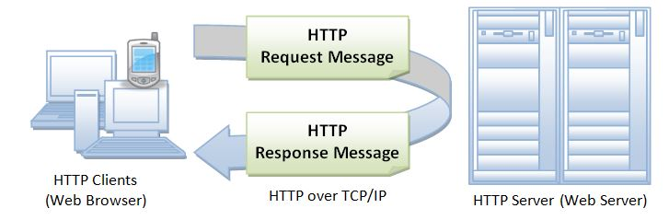
Understanding HTTP Basics
Stands for "Hypertext Transfer Protocol."
HTTP is based on a request and a response.
HTTP is the protocol used to transfer data over the web.
HTTP is the protocol that is used by web servers and browsers to communicate.
Fig : HTTP
Source:
https://www3.ntu.edu.sg/home/ehchua/programming/webprogramming/HTTP_Basics.html
Notes:
Understanding HTTP Basics
Stands for "Hypertext Transfer Protocol."
HTTP is based on a request and a response.
HTTP is the protocol used to transfer data over the web.
HTTP is the protocol that is used by web servers and browsers to communicate.

Slide 8
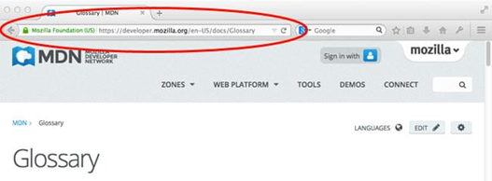
What is a Web Page?
A web page can contain huge information including text, graphics, audio, video, and hyperlinks.
These hyperlinks are the link to other web pages.
Source:
https://developer.mozilla.org/enUS/docs/Learn/Commonquestion/Pagessitesserversandsearchengines
Notes:
What is a WebPage?
A web page can contain huge information including text, graphics,audio,video and hyperlinks.
These hyperlinks are the link to other web pages.

Slide 9
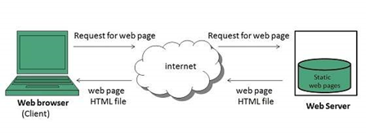
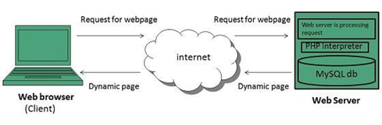
Type of Web Pages
Image: Static Web page
Image: Dynamic Web page
Source:
https://www.tutorialspoint.com/internet_technologies/web_pages.htm
Notes:
Type of Web Pages
Web page is a document available on world wide web. Web Pages are stored on web server and can be viewed using a web browser. A web page can cotain huge information including text, graphics, audio, video and hyper links. These hyper links are the link to other web pages.
Static web pages are also known as flat or stationary web page. They are loaded on the client’s browser as exactly they are stored on the web server. Such web pages contain only static information. User can only read the information but can’t do any modification or interact with the information.
Static web pages are created using only HTML. Static web pages are only used when the information is no more required to be modified.
Dynamic web page shows different information at different point of time. It is possible to change a portaion of a web page without loading the entire web page.
Reference - https://www.tutorialspoint.com/internet_technologies/web_pages.htm

Slide 10
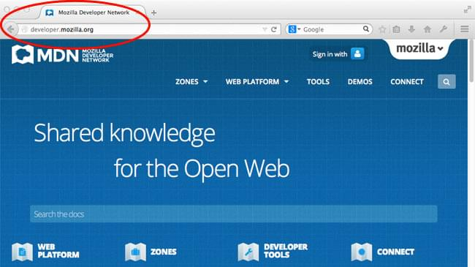
What is a Website?
A website is a collection of linked web pages that shares a unique domain name.
Source:
https://developer.mozilla.org/enUS/docs/Learn/Commonquestion/Pagessitesserversandsearchengines
Notes:
What is a Website?
A website is a collection of linked web pages that shares a unique domain name.

Slide 11

What is a Web Application?
Web application is a client-side and server-side software application in which the client runs or request in a web browser.
Source:
https://www.appverticals.com/blog/web-app-vs-website/
Notes:
What is a Web Application?
Web application is a client-side and server-side software application in which the client runs or request in a web browser.

Slide 12
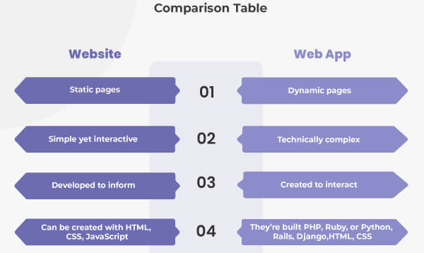
Difference between Web Application & Website
Source:
https://www.spaceotechnologies.com/webapplication-vs-website-difference/
Notes:
Look at the slide to see the difference between a website and a web application.

Slide 13
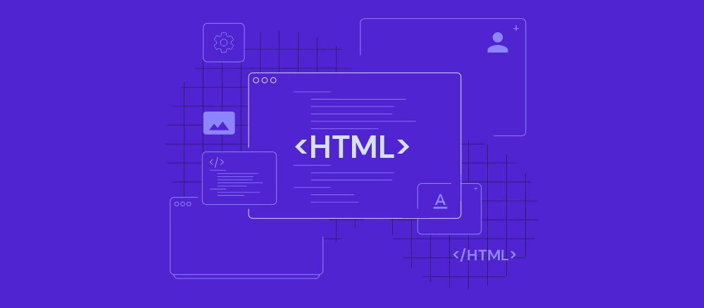
Introduction
What is HTML?
HTML stands for Hyper Text Markup Language
HTML elements are the building blocks of HTML pages
HTML describes the structure of Web pages using Hypertext markup language
HTML elements are represented by tags
When you test your page on browsers. Browsers do not display the HTML tags but use them to render the content of the page.
HTML page extension always will be .html (example.html)
Source:
https://www.hostinger.com/tutorials/what-is-html
Notes:
as there is a possibility that students have learned about HTML in that institute so in this slide instead of explaining the concept to trainer can interact with the students and try to get the answers from the students like what's the full form of HTML, what will be the extension of HTML file, what is the symbol of tag, what do you mean by HTML element etc
--------------------------------------------------------------------------------------
Introduction
What is HTML?
HTML stands for Hyper Text Markup Language
HTML elements are the building blocks of HTML pages
HTML describes the structure of Web pages using Hypertext markup language
HTML elements are represented by tags
When you test your page on browsers. Browsers do not display the HTML tags but use them to render the content of the page.
HTML page extension always will be .html (example.html)

Slide 14

Features of HTML:
It is easy to learn and easy to use.
It is platform-independent.
Images, video, and audio can be added to a web page.
Hypertext can be added to the text.
It is a markup language.
Notes:
Based on the response you receive from the students for the first slide trainer can directly ask to list out some of the features of HTML or trainer can explain the use of HTML
---------------------------------------------------------------------------------------
Features of HTML
It is easy to learn and easy to use.
It is platform-independent.
Images, video, and audio can be added to a web page.
Hypertext can be added to the text.
It is a markup language.

Slide 15
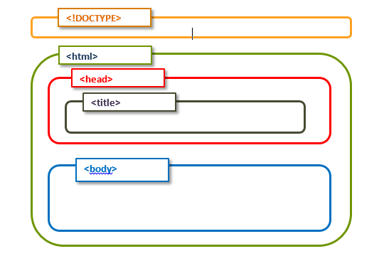
Page Structure of HTML
Source:
https://qatechhub.com/html-page-structure-nesting/
Notes:
As the basic introduction of HTML is covered so now it's time to write the code for the client side pages. here the trainer will explain the basic page structure of HTML
--------------------------------------------------------------------------------------------
Page Structure of HTML
<DOCTYPE! html>: This tag is used to tell the HTML version. This currently tells that the version is HTML 5.
<html>: This is called the HTML root element and is used to wrap all the code.
<head>: Head tag contains metadata, title, page CSS etc. All the HTML elements that can be used inside the <head> element are: <style> ,<title> ,<base> ,<noscript> ,<script> ,<meta> ,<title> ,etc.
<body>: The body tag is used to enclose all the data that a web page has from texts to links. All of the content that you see rendered in the browser is contained within this element.

Slide 16

Lab 10: Understanding the HTML Structure​
Notes:
Here the trainer will inform students to install Visual Studio code in their system to execute HTML code and switch the window to the Visual Studio code and performs the first hand-on classroom exercise

Slide 17
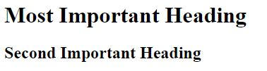
HTML Heading Tags:
HTML headings can be defined with <h1> to <h6>
<h1> - most important heading
<h6> - least important heading
Search engines use the headings to index the structure and content of your web pages.
Example:
<h1> Most Important Heading </h1>
<h2> Second Important Heading </h2>
Notes:
Now it's time to talk regarding some of the heading texts which are used in HTML.
------------------------------------------------------------------------------------------
HTML Heading Tags:
HTML headings can be defined with <h1> to <h6>
<h1> represents most important heading
<h6> represents least important heading
Search engines use the headings to index the structure and content of your web pages.
Example:
<h1> Most Important Heading </h1>
<h2> Second Important Heading </h2>
Output is shown on the slide

Slide 18
HTML Formatting Tags:
<b> - Apply Bold effect on content
<i> - Apply italic effect on content
<u> - Apply underline to the content
<strong> - Add on the importance to the content
<em> - Apply emphasized effect on content
<ins> - Insert content to web page
<del> - Use to delete the content
<mark> - highlight the content
<sub> - Subscript text : ex – X2
<sup> - Superscript text : ex – X2
<small> - write content in smaller font size than normal font size
<big> - Write content in bigger font size than normal font size
<pre> - Used to display content as pre formatted
Notes:
As per HTML4 the students might have idea about some of the formatting tags so the trainer first of all tried to ask some of the tags which are known to students and then the remaining will be explained.
-----------------------------------------------------------------------------------
HTML Formatting Tags
HTML uses elements like <b> and <i> for formatting output, like bold or italic text.
Formatting elements were designed to display special types of text:
<b> - Bold text
<strong> - Important text
<i> - Italic text
<em> - Emphasized text
<mark> - Marked text
<small> - Small text
<del> - Deleted text
<ins> - Inserted text
<sub> - Subscript text
<sup> - Superscript text
<b> and <strong> Tags
The <b> tag is a physical tag that stands for bold text, whereas the <strong> tag being a logical tag is used to emphasize the importance of the text.
<i> and <em> Tags
The <i> and <em> tags define italic text. The <i> tag is only responsible for visual appearance of the enclosed text, without any extra importance. The <em> tag defines emphasized text, with added semantic importance.
<pre> Tag
The <pre> tag is used to define preformatted text. The browsers render the enclosed text with white spaces and line breaks.
<mark> Tag
The <mark> tag is used to present a part of text in one document as marked or highlighted for reference purposes.
<small> Tag
The <small> tag decreases the text font size by one size smaller than a document's base font size (from medium to small, or from x-large to large).
The tag usually contains items of secondary importance such as copyright notices, side comments, or legal notices.
<big> Tag
The <big> tag defines bigger text.
<del> and <s> Tags
The <del> tag specifies a part of the text that was deleted from the document. Browsers display this text as a strikethrough.
The content of both tags is displayed as strikethrough. However, despite the visual similarity, these tags cannot replace each other.
<ins> and <u> Tags
The <ins> tag defines the text that has been inserted (added) to the document. The content of the tag is displayed as underlined.
<sub> and <sup> Tag
The <sub> defines subscript texts. Subscript text is under the baseline of other symbols of the line and has a smaller font. The <sup> tag defines superscript, which is set slightly above the normal line of type and is relatively smaller than the rest of the text. The baseline passes through the upper or lower edge of the symbols.

Slide 19
Lab 11: Use of Formatting Tags
Notes:
Trainer will switch the window to the Visual Studio code and performs the hand-on classroom exercise

Slide 20
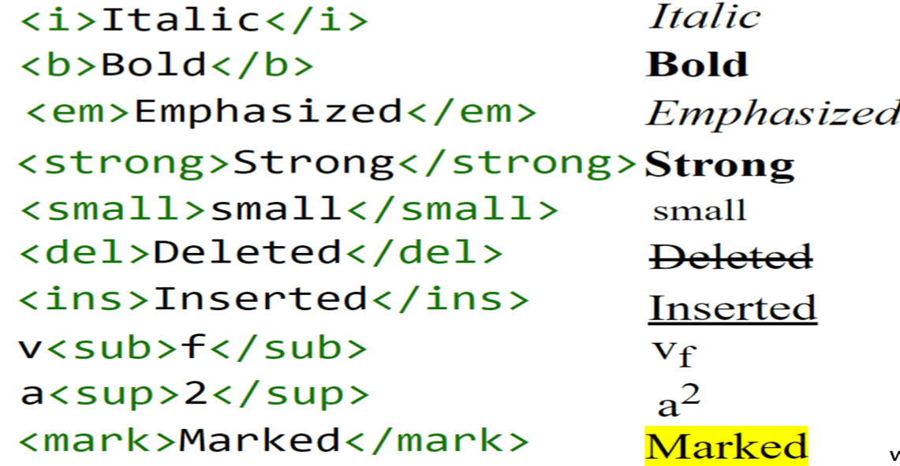
Example of Formatting Tags:
Source:
https://www.web4college.com/html/socialImages/html-text-formatting.png
Notes:
As a result of classroom exercise the trainer can do the discussion using this slide.
Example for some formatting tags are showcased on the slide

Slide 21
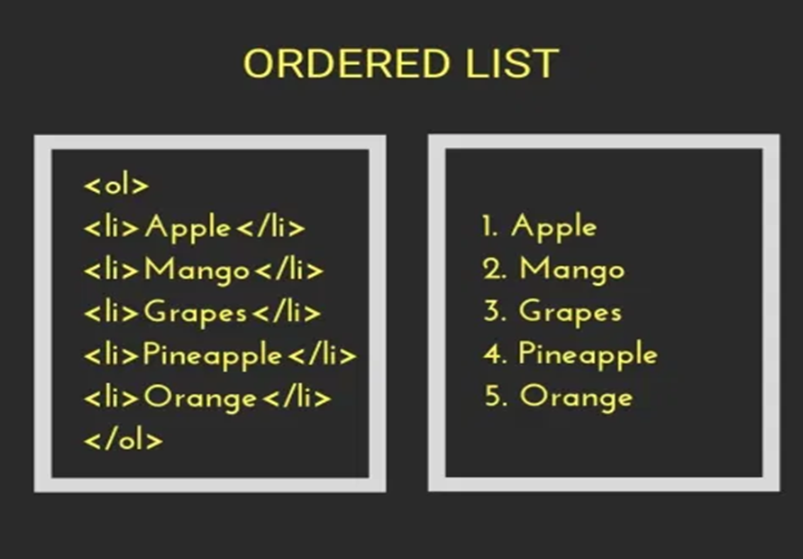
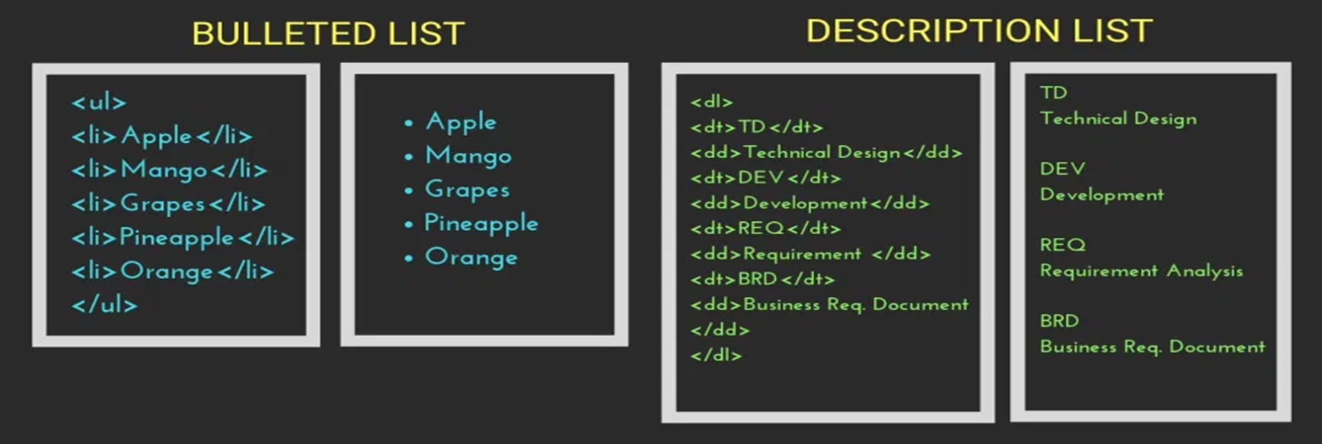
HTML List:
HTML List Tags are used to specify information in the form of a list.
Types of List
Source:
https://www.tutorialbrain.com/html_tutorial/html_lists/
Notes:
Trainer will interact with stuents and try to know their knowledge on list. And then explain the concept using examples.
----------------------------------------------------------------
HTML List
HTML List Tags are used to specify information in the form of list.
Following are the types of List
Ordered List
Unordered List
Description List

Slide 22
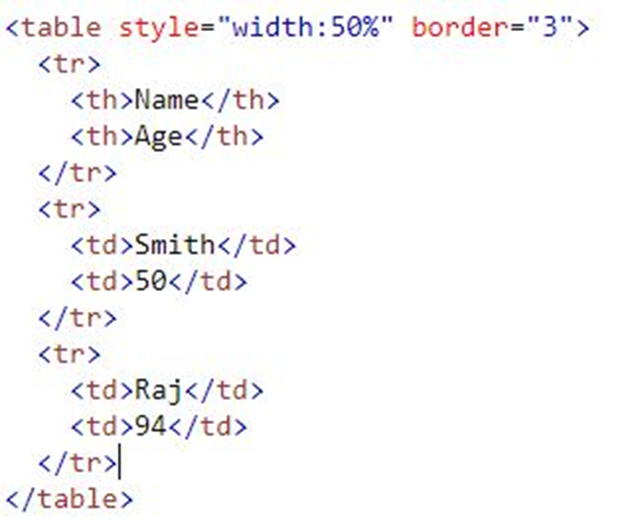
HTML Table:
HTML tables are used for displaying data that make sense in spreadsheet software.
<table> – This tag is used to define Tables.
<tr> – table row.
<td> –table data cells.
<th> – For table heading which is bold and center.
Name Age
Smith 50
Raj 94
Source:
https://www.w3schools.com/html/html_tables.asp
Notes:
Trainer will ask students about table that it is consist of what??? And then explain the tags used to create a tabular format.
----------------------------------------------------------------------------------------------------
HTML Table
HTML tables are used for displaying data that make sense in spreadsheet software.
<table> – This tag is used to define Tables.
<tr> – table row.
<td> –table data cells.
<th> – For table heading which is bold and center.

Slide 23
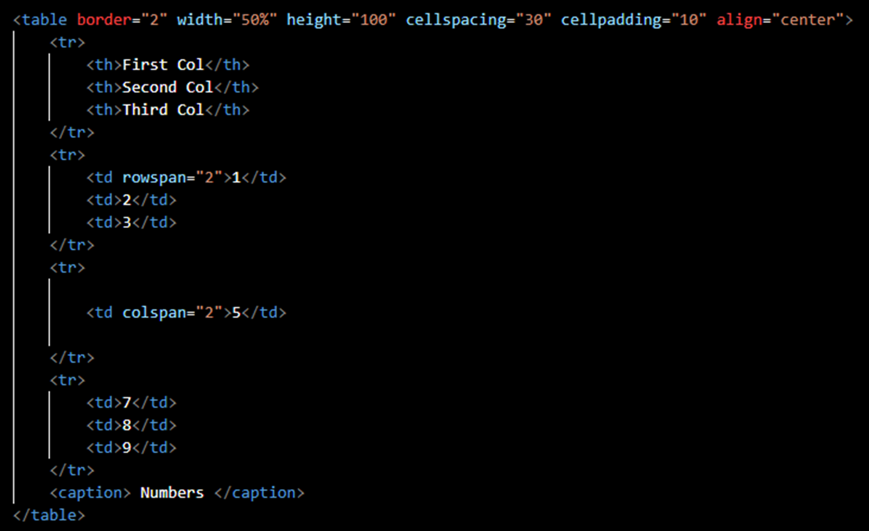
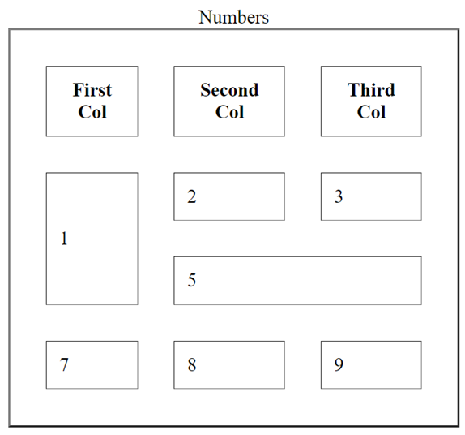
HTML Table Attributes:
Border – used to add a border to the table
Cellspacing – used to add space between cells
Cellpadding – used to add space between cell border and content
Align – used to give alignment to table
HTML <td> (Cell) Attributes:
Colspan – used to combine 2 or more colums
Rowspan – used to combine 2 or more rows
Notes:
Here trainer will also explain the different attributes used in HTML tables like border, cellspacing, cellpadding, align also he will introduce the 2 most important attributes of cell - to merge multiple columns or multiple rows
------------------------------------------------------------------------------
HTML Table Attributes
Border – used to add a border to the table
Cellspacing – used to add space between cells
Cellpadding – used to add space between cell border and content
Align – used to give alignment to table
HTML <td> Tag attributes
Colspan – used to combine 2 or more colums
Rowspan – used to combine 2 or more rows

Slide 24

HTML Image:
<img> - Image Tag is used to add image on web page
Syntax: <img src=“ path of image ” />
Attributes:
height – used to set height of image
width – used to set width of image
alt – used to show any error message as alternate to image
Example:
<img src=“demo.jpg” height=“300” width=“300” alt=“error” />
Notes:
As we know while developing any of the web based application that does not contain only taxt data it also contains image as a data, link as a data n many more. so so far we have just learned that how we can keep the text data on any HTML page now it's time to learn how we can keep the images on HTML page
------------------------------------------------------------------------------------------------------------------------
HTML Image
<img> - Image Tag is used to add image on web page
Syntax:
<img src=“ path of image ” />
Attributes:
height – used to set height of image
width – used to set width of image
alt – used to show any error message as alternate to image

Slide 25
HTML Hyper Link:
<a> - Anchor Tag is used to create hyper links
Syntax: <a href=“ link on which you want to redirect ”> LinkText </a>
Attributes:
target – used to give location where to open the link content
Values for target attribute - _self, _blank, _top
title – used to create tooltip text
Example:
<a href=“https://www.edunetfoundation.org” target=“_blank” title=“link for Edunet Foundation Website”> Visit Edunet Foundation!</a>
Visit Edunet Foundation
When User clicks on Visit Edunet Foundation Link, HTML page will be redirected to Edunet Foundation Website
Notes:
Here the trainer will make sure that students understand how to create the hyperlinks because the hyperlinks are the one through which we can redirect from one page to the another page
-------------------------------------------------------------------------------------------------------------
HTML Hyper Link
<a> - Anchor Tag is used to create hyper links
Syntax:
<a href=“ link on which you want to redirect ”> LinkText </a>
Attributes:
target – used to give location where to open the link content
Values for target attribute - _self, _blank, _top
title – used to create tooltip text

Slide 26
Lab 12 : Create a Hyperlink to redirect to another Page
Notes:
Trainer will switch the window to the Visual Studio code and performs the hand-on classroom exercise. trainer can also showcase that how we can create an image as hyperlink

Slide 27
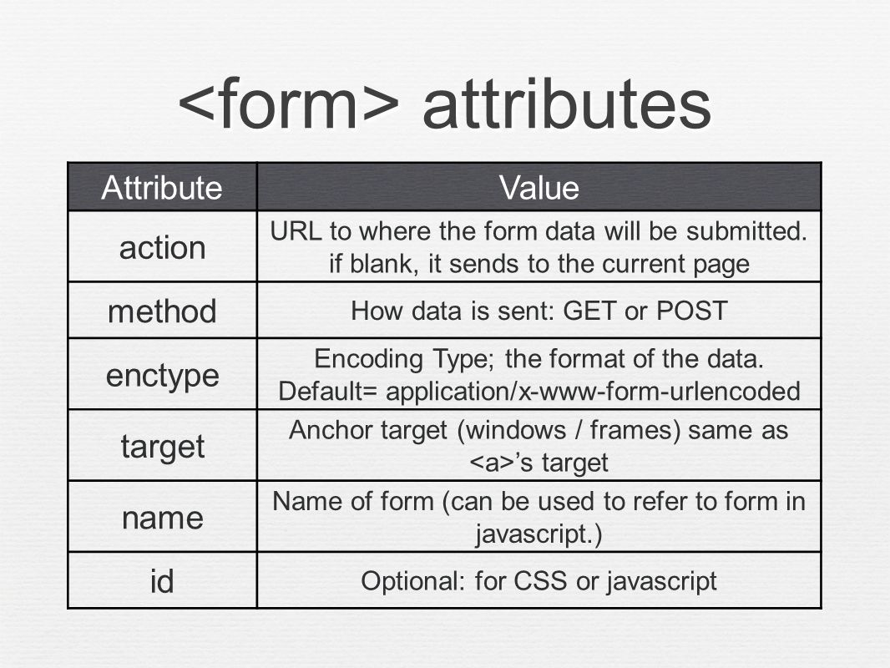
HTML Form:
HTML Forms are required to collect different kinds of user inputs, such as contact details like name, email address, phone numbers, or details like credit card information, etc.
Syntax:
<form>
- - - -
- - - -
</form>
Notes:
Here the trainer will explain the use of form in HTML as we know the HTML is mainly used for handling the client side data so whenever we want to create a client-server architecture kind of thing that means the client sends the request for a particular page to the server side so for such kind of things we required the client interaction and the form is the one through which we can add the client interaction at client site
-----------------------------------------------------------------------------------------------------------------------
HTML Forms
HTML Forms are required to collect different kinds of user inputs, such as contact details like name, email address, phone numbers, or details like credit card information, etc.
Form tag consists of various attributes
Action – URL to where the form data will be submitted
Method – How data is sent : Get or post
Target – provides targeted windows or frames to redirect on next page
Name – can be used to refer to identify form

Slide 28
HTML Form Sub Tags:
<input> - Input tag is used to take input from user
Attribute of input tag is type
different values of type attribute create different types of input
Type = text – Create textbox
Type = password – Create textbox but text is in not visible form
Type = number – Create a scroll up and down for number value
Type = radio – Create radio button
Type = checkbox – Create checkbox
Type = file – Create option for file uploading
Type = submit – Create submit button
Type = reset – Create reset button
Notes:
The trainer will explain how the different types of input that can be taken from the client
------------------------------------------------------------------------------------------------
<input> - Input tag is used to take input from user
Attribute of input tag is type
different values of type attribute create different type of input
Type = text – Create textbox
Type = password – Create textbox but text is in not visible form
Type = number – Create a scroll up and down for number value
Type = radio – Create radio button
Type = checkbox – Create checkbox
Type = file – Create option for file uploading
Type = submit – Create submit button
Type = reset – Create reset button

Slide 29
HTML Form Sub Tags:
To create drop-down list
<select>
<option> item </option>
<option> item </option>
</select>
To create a textbox with bigger input size
<textarea rows=“ “ cols=“ “> </textarea>
To create a button
<button> Name of button </button>
Notes:
HTML Form Sub tags:
To create drop down list
<select>
<option> item </option>
<option> item </option>
</select>
To create textbox with bigger input size
<textarea rows=“ “ cols=“ “> </textarea>
To create button
<button> Name of button </button>

Slide 30
Lab 13: Create a Registration Form
Notes:
Trainer will switch the window to the Visual Studio code and performs the hand-on classroom exercise. Trainer can also discuss the various registration forms required for different types of applications also explain the use of form for taking the feedback and contact details as well

Slide 31
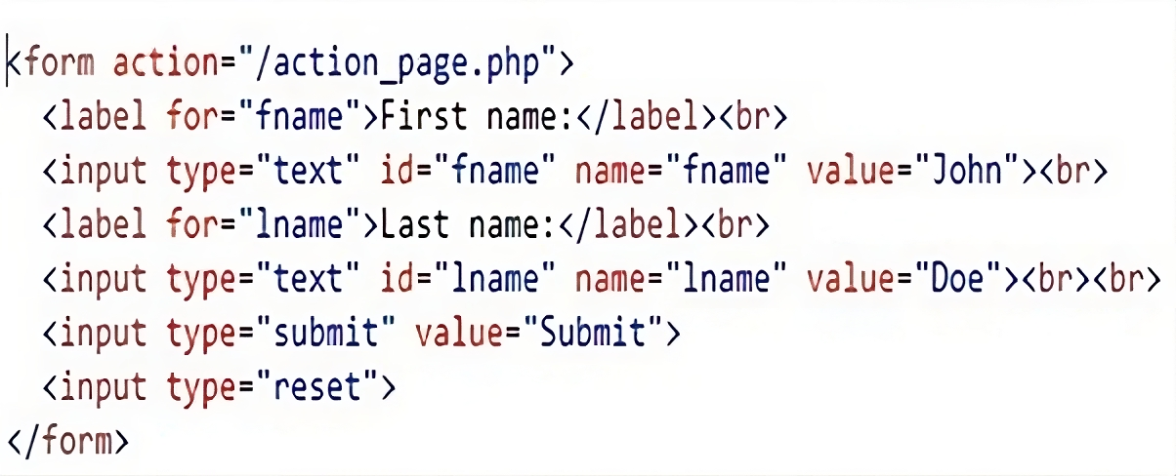
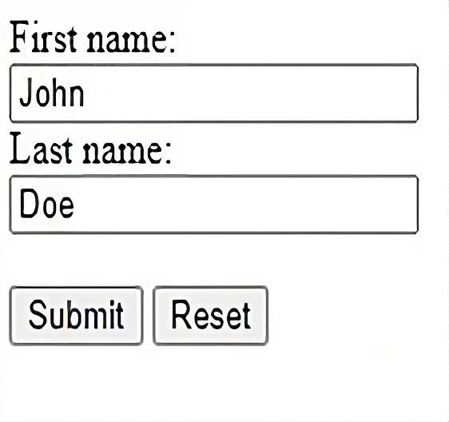
HTML Form Example Code:
Source:
https://www.w3schools.com/html/tryit.asp?filename=tryhtml_input_reset
Notes:
You can see a HTML code snippet which creates a HTML form with different form elements.
Trainer can discuss the use of form

Slide 32
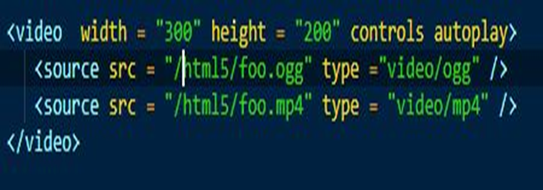
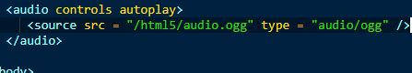
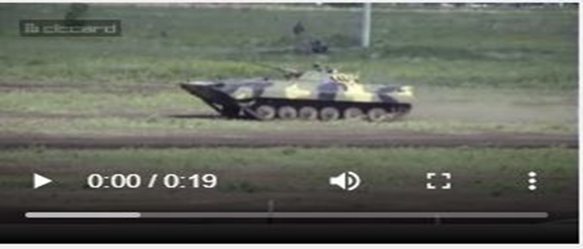
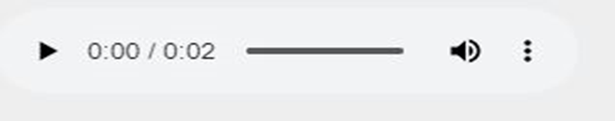
HTML Multi Media:
Multimedia on the web page is audio, videos, movies, and animations.
Video Files:
Audio Files:
Source:
https://www.tutorialspoint.com/html5/html5_audio_video.htm
Notes:
HTML page also contains the multimedia files like audio files and video files so here the trainer will explain that how we can keep the audio and video files on HTML page
--------------------------------------------------------------------------------------
HTML Multi-Media
Multimedia on the web page, is audio, videos, movies, and animations.
In the slide, as an example of multimedia in HTML, code snippets of HTML have been shown which creates audio control and video control.

Slide 33
HTML Graphics:
Graphics are used for everything from enhancing the appearance of Web pages to serving as the presentation and user interaction layer for full-fledged Web Applications.
<svg height="100" width="100"> <circle cx="50" cy="50" r="40" stroke="black" stroke-width="3" fill="red" /> </svg>
Source:
https://www.w3schools.com/graphics/svg_circle.asp
Notes:
HTML page also contains the graphics as well so here the trainer will explain that how we can keep or draw the graphics on HTML page. Also explain the difference between canvas and SVG.
------------------------------------------------------------------------------------------
HTML Graphics
Graphics are used for everything from enhancing the appearance of Web pages to serving as the presentation and user interaction layer for full-fledged Web Applications.

Slide 34
Lab 14: How to Put Media Files and Create Graphics on HTML Page
Notes:
Trainer will switch the window to the Visual Studio code and performs the hand-on classroom exercise. Explain difference between Canvas and SVG. Also mention which is better and when to use it.

Slide 35
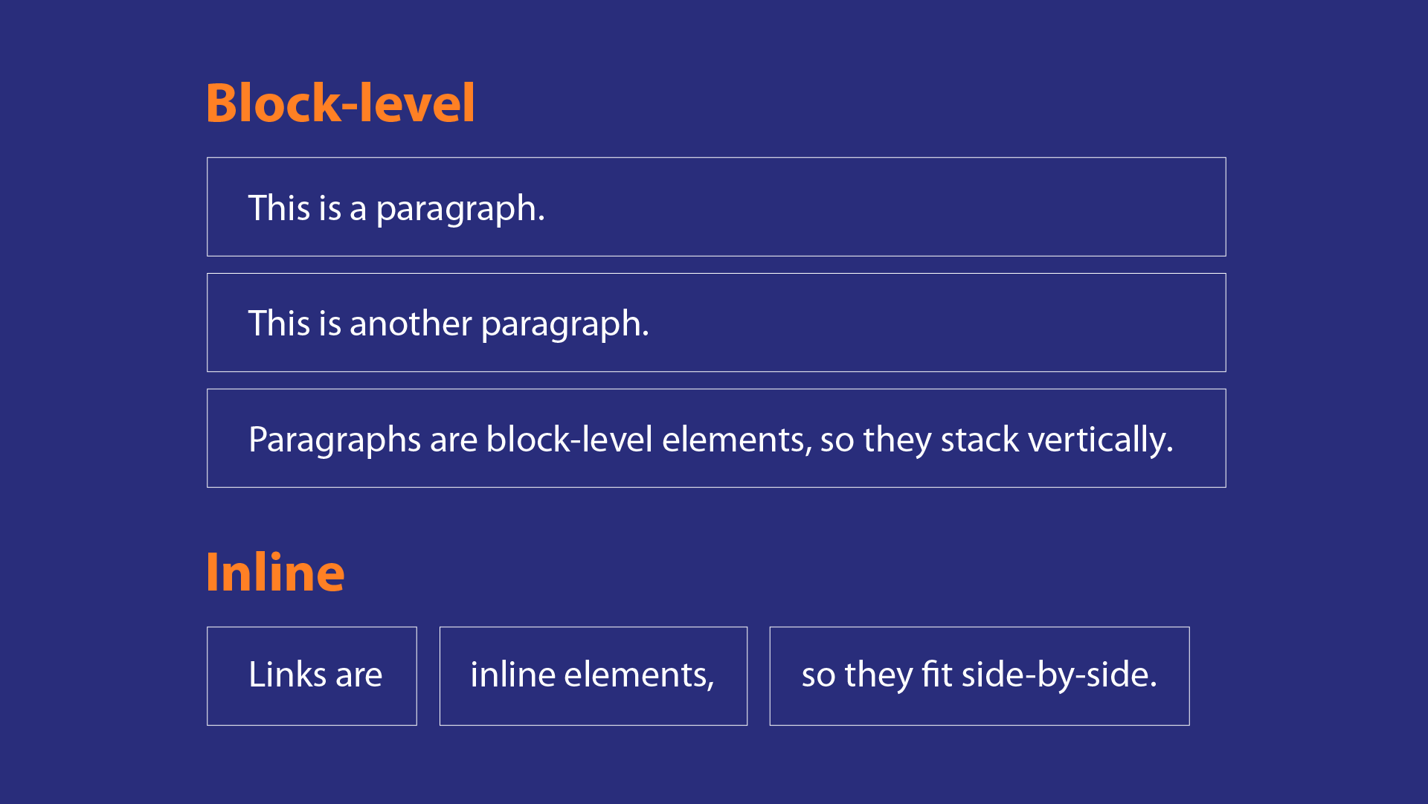
HTML Block Component
<div>: A block-level element is an HTML element that takes up the full width of the element that contains it.
<span>: An inline element is an HTML element that only takes up the width that its content takes up.
Notes:
As all the major tags which are used to keep the content on HTML page is covered so now it's time to understand that how we can arrange the components or content on HTML page for creating a proper layout or design of any web page we need to understand the block components and semantic tegs.
The trainer will explain the use of div tag, frame tag and span tag. also mention where to use and why to use
------------------------------------------------------------------------------------------------------------
HTML Block components
A block-level element is an HTML element that takes up the full width of the element that contains it. It is represented as (<div>)
An inline element is an HTML element that only takes up the width that its content takes up. It is represented as (<span>)

Slide 36
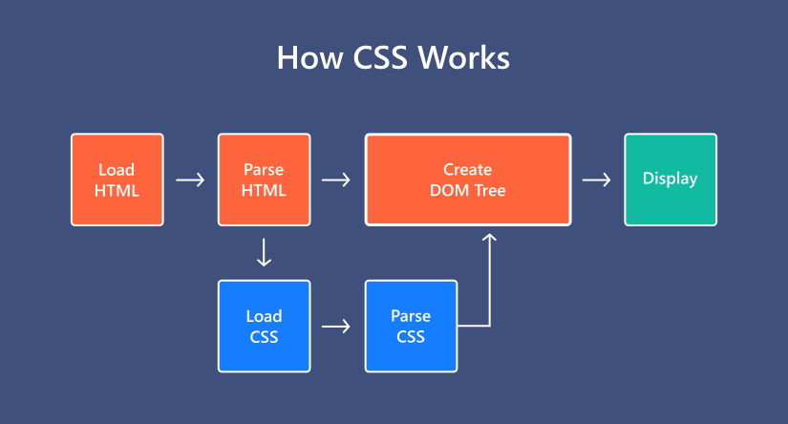
Introduction
What is CSS?
CSS (Cascading Style Sheets) is used to styles web pages. Cascading Style Sheets are fondly referred to as CSS.
The reason for using this is to simplify the process of making web pages presentable.
Source:
https://blog.templatetoaster.com/what-is-css/
Notes:
The trainer can interact with the students and try to know that what actually students understand by CSS and based on the answer the trainer can provide the knowledge on CSS
------------------------------------------------------------------------------------------------------------------------
Introduction
What is CSS?
CSS (Cascading Style Sheets) is used to styles web pages. Cascading Style Sheets are fondly referred to as CSS.
The reason for using this is to simplify the process of making web pages presentable.
It allows you to apply styles on web pages. More importantly, it enables you to do this independently of the HTML that makes up each web page.

Slide 37
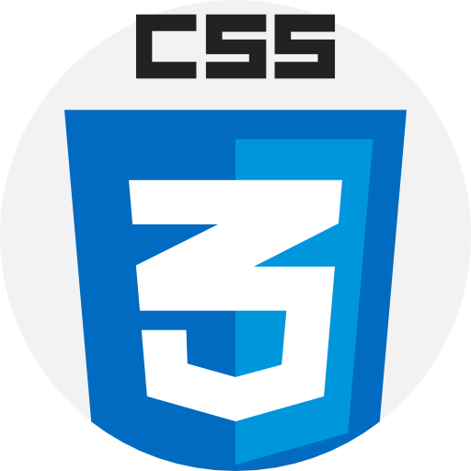
Characteristics of CSS:
Maintenance: It is easy to maintain, changing in a single place will affect globally in your web site. No need to change every specific place.
Time-saving: You can easily use any single CSS script at multiple places.
Support: CSS is supported by all the browsers and search engines.
Notes:
Based on the earlier interaction the trainer can ask students to list out the characteristics of CSS or the use of CSS or the features of CSS
------------------------------------------------------------------------------
Characteristics of CSS:
Maintenance: It is easy to maintain, changing in a single place will affect globally in your web site. No need to change every specific place.
Time-saving: You can easily use any single CSS script at multiple places.
Support: CSS is supported by all the browsers and search engines.

Slide 38
Advantages & Disadvantages of CSS:
Advantages of CSS:
CSS is compatible with all the devices.
With the help of CSS, website maintenance is easy and faster.
CSS support consistent and spontaneous changes.
CSS make the website faster and enhances search engine capabilities to crawl the web pages
Disadvantages of CSS:
In CSS, there is a cross browsers issue if you design anything and check on chrome it looks perfect but that does not mean it will look the same in the other browsers. Then you have to add the script for that browser also.
There is a lack of security in CSS.
Notes:
Advantages of CSS:
CSS is compatible with all the devices.
With the help of CSS, website maintenance is easy and faster.
CSS support consistent and spontaneous changes.
CSS make the website faster and enhances search engine capabilities to crawl the web pages
It holds a special feature that is the ability to re-position.
Disadvantages of CSS:
In CSS, there is a cross browsers issue if you design anything and check on chrome it looks perfect but that does not mean it will look the same in the other browsers. Then you have to add the script for that browser also.
There is a lack of security in CSS.

Slide 39
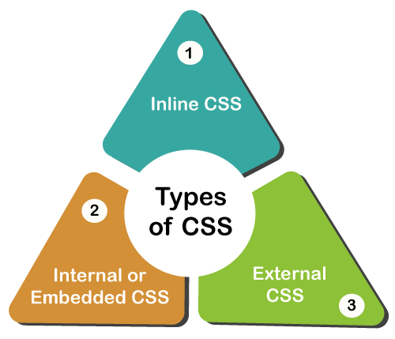
Types of CSS
Source:
https://www.javatpoint.com/types-of-css
Notes:
Here the trainer will explain the different ways to apply the CSS properties on HTML element
-----------------------------------------------------
Types of CSS
There are 3 types of CSS
Internal CSS, External CSS and Inline CSS

Slide 40
Types of CSS
Inline CSS
The CSS ruleset should be within the HTML file in the head section.
i.e the CSS is embedded within the HTML file.
<tag style="property: value"> </tag>
Internal CSS
The CSS ruleset should be within the HTML file in the head section
i.e the CSS is embedded within the HTML file.
<style type="text/css">div { color: #444;}</style>
External CSS
External CSS contains a separate CSS file that contains only style property with the help of tag attributes.
selector{
property1: value1;
property2: value2;
}
<link rel="stylesheet" type="text/css" href="/style.css" />
Notes:
Let's understand each in detail
Inline: Inline CSS contains the CSS property in the body section attached with the element known as inline CSS.
Internal or Embedded: The CSS ruleset should be within the HTML file in the head section i.e the CSS is embedded within the HTML file.
External: External CSS contains a separate CSS file that contains only style property with the help of tag attributes.
External CSS: External CSS contains a separate CSS file with a .css extension which contains only style property with the help of tag attributes.
selector{
property1: value1;
property2: value2;
}
Include external CSS file: The external CSS file is linked to the HTML document using a link tag.
<link rel="stylesheet" type="text/css" href="/style.css" />
Internal CSS or Embedded: CSS is embedded within the HTML file using a style HTML tag.
<style type="text/css">div { color: #444;}</style>
Inline CSS: It contains CSS properties in the body section specified within HTML tags.
<tag style="property: value"> </tag>

Slide 41
Lab 15: Different Ways to apply CSS on HTML Elements
Notes:
Trainer will switch the window to the Visual Studio code and performs the hand-on classroom exercise. The trainer will also explain the syntax of CSS

Slide 42
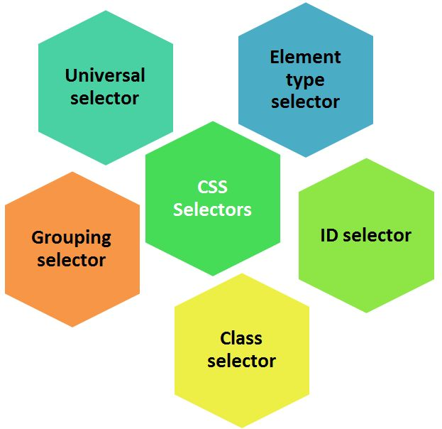
CSS Selectors
Source:
https://www.c-sharpcorner.com/UploadFile/9a9e6f/selectors-in-css/
Notes:
As per the syntax of CSS here the trainer will try to explain the different types of selectors through which we can identify HTML element
---------------------------------------------------------------------
CSS SELECTORS
There are various types of selectors to identify html element such as
ID selector, class selector, tag selector, grouping selector, universal selector, etc

Slide 43
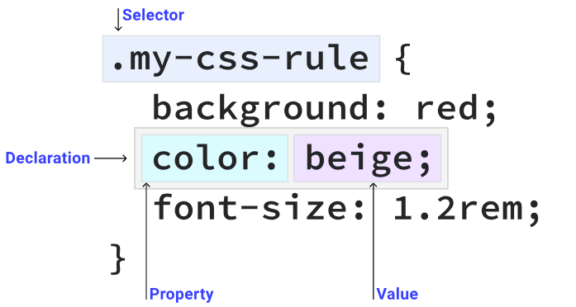
Introduction
Selectors
To apply CSS to an element you need to select it.
CSS provides you with a number of different ways to do this
If you've got some text that you only want to be larger and red if it's the first paragraph of an article, how do you do that?
<article> <p>I want to be red and larger than the other text.</p> <p>I want to be normal sized and the default color.</p> </article>
You use a CSS selector to find that specific element and apply a CSS rule, like this.
article p:first-of-type { color: red; font-size: 1.5em; }
Source:
https://web.dev/learn/css/selectors/
Notes:
Selectors
To apply CSS to an element you need to select it.
CSS provides you with a number of different ways to do this
If you've got some text that you only want to be larger and red if it's the first paragraph of an article, how do you do that?
<article> <p>I want to be red and larger than the other text.</p> <p>I want to be normal sized and the default color.</p> </article>
You use a CSS selector to find that specific element and apply a CSS rule, like this.
article p:first-of-type { color: red; font-size: 1.5em; }

Slide 44
Type Selector
A type selector matches a HTML element directly.
section { padding: 2em; }
This rule causes every <section> element to have 2em of padding on all sides.
Class selector
A HTML element can have one or more items defined in their class attribute. The class selector matches any element that has that class applied to it.
<div class="my-class"></div> <button class="my-class"></button> <p class="my-class"></p>
Any element that has the class applied to it will get colored red:
.my-class { color: red; }
Notes:
Here the trainer will explain the different selectors and also explain the difference between the various selectors trainer will also explain regarding with selectors must be used in which type of scenario
--------------------------------------------------------
Type selector
A type selector matches a HTML element directly.
section { padding: 2em; }
This rule causes every <section> element to have 2em of padding on all sides.
Class selector
A HTML element can have one or more items defined in their class attribute. The class selector matches any element that has that class applied to it.
<div class="my-class"></div> <button class="my-class"></button> <p class="my-class"></p>
Any element that has the class applied to it will get colored red:
.my-class { color: red; }

Slide 45
Grouping Selectors
A selector doesn't have to match only a single element. You can group multiple selectors by separating them with commas:
strong,
em,
.my-class,
[lang] {
color: red;
}
ID selector
An HTML element with an id attribute should be the only element on a page with that ID value. You select elements with an ID selector like this:
#rad {
border: 1px solid blue;
}
This CSS would apply a blue border to the HTML element that has an id of rad, like this:
<div id="rad"></div>
Notes:
Grouping selectors
A selector doesn't have to match only a single element. You can group multiple selectors by separating them with commas:
strong,
em,
.my-class,
[lang] {
color: red;
}
ID selector
An HTML element with an id attribute should be the only element on a page with that ID value. You select elements with an ID selector like this:
#rad {
border: 1px solid blue;
}
This CSS would apply a blue border to the HTML element that has an id of rad, like this:
<div id="rad"></div>

Slide 46
Universal selector
Also known as a wildcard—matches any element.
* {
color: hotpink;
}
This rule causes every HTML element on the page to have hotpink text.
Attribute selector
Instruct CSS to look for attributes by wrapping the selector with square brackets ([ ]).
[data-type='primary'] {
color: red;
}
This CSS looks for all elements that have an attribute of data-type with a value of primary, like this:
<div data-type="primary"></div>
Instead of looking for a specific value of data-type, you can also look for elements with the attribute present, regardless of its value.
[data-type] { color: red;
}<div data-type="primary"></div>
<div data-type="secondary"></div>
Both of these <div> elements will have red text.
Notes:
Universal selector—also known as a wildcard—matches any element.
* {
color: hotpink;
}
This rule causes every HTML element on the page to have hotpink text.
Attribute selector
Instruct CSS to look for attributes by wrapping the selector with square brackets ([ ]).
[data-type='primary'] {
color: red;
}
This CSS looks for all elements that have an attribute of data-type with a value of primary, like this:
<div data-type="primary"></div>
Instead of looking for a specific value of data-type, you can also look for elements with the attribute present, regardless of its value.
[data-type] {
color: red;
}<div data-type="primary"></div>
<div data-type="secondary"></div>
Both of these <div> elements will have red text.

Slide 47
Lab 16 : Use of Simple Selectors, Color Properties, Background Properties
Notes:
Trainer will switch the window to the Visual Studio code and performs the hand-on classroom exercise.

Slide 48
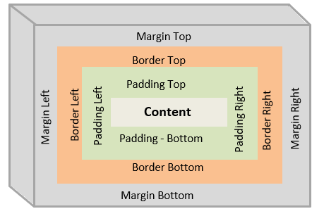
Box Model
Source:
https://www.csssolid.com/css-box-model.html
Notes:
The trainer will explain the importance of box model and explain the components of box model
----------------------------------------------------------------------------------------------
BOX MODEL
Box model consists of 4 elements : content, padding, margin and border

Slide 49
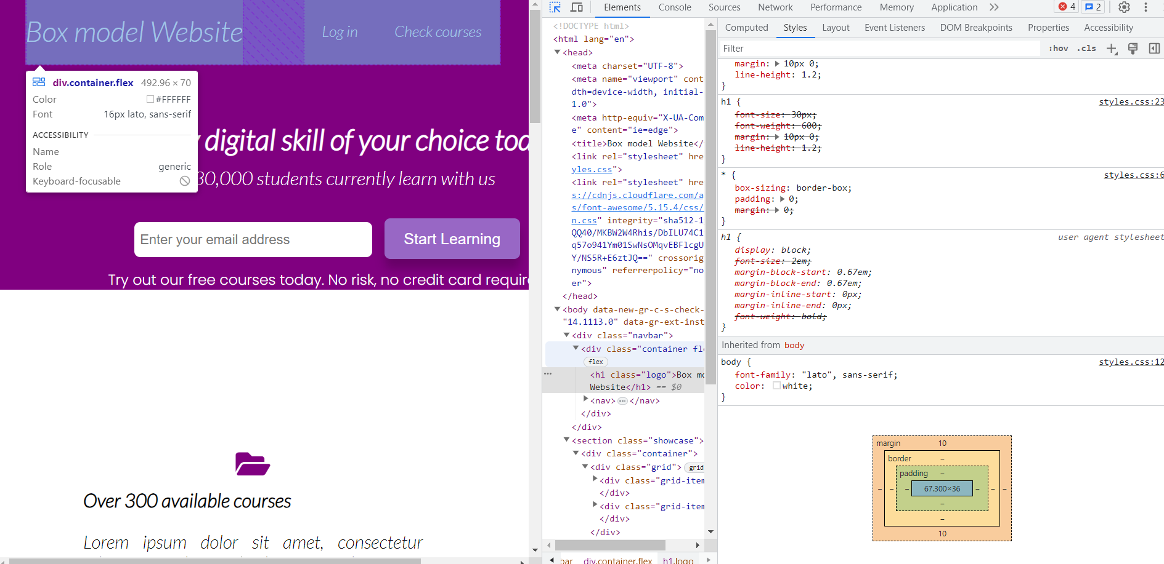
What Is The CSS Box Model?
The CSS Box Model describes all the HTML elements of the webpage as rectangular boxes.
As shown in the graphic below, let it be the logo, contents of the navigation bar or buttons, everything is a box.
BOX MODEL
Chrome dev tool
Box model
Notes:
What Is The CSS Box Model?
The CSS Box Model describes all the HTML elements of the webpage as rectangular boxes.
As shown in the graphic below, let it be the logo, contents of the navigation bar or buttons, everything is a box.

Slide 50
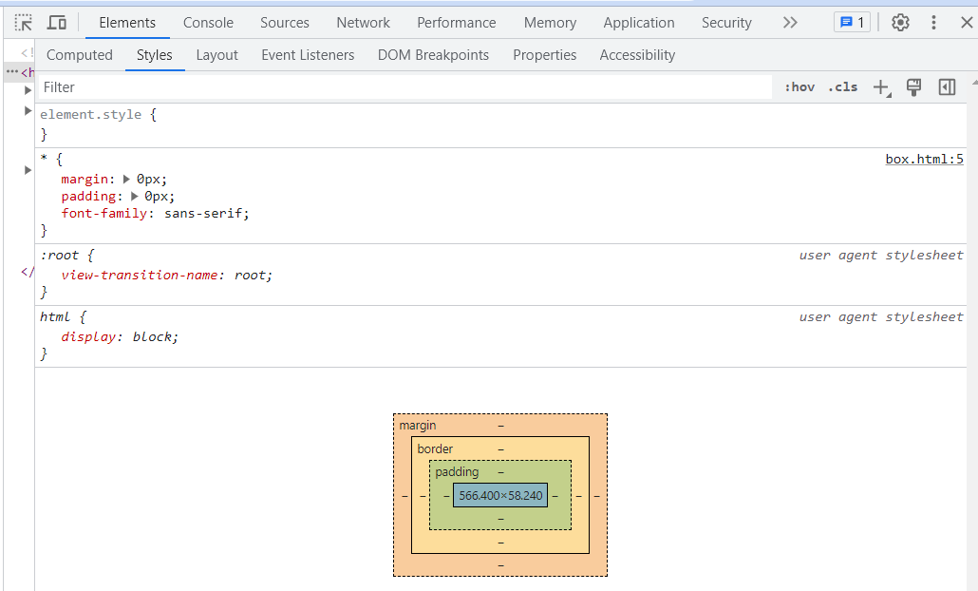
CSS Box-Model
It has 4 Layers:
1st layer: Content
2nd layer: Padding
3rd layer: Border
4th layer: Margin
Box 1
Margin
Border
Padding
Content
Notes:
Here Trainer needs to explain all the various properties of padding, border, margin and also mention the shorthand properties which can be used. trainer needs to also explain the requirement of various properties and the shorthand property
----------------------------------------------------------------------
CSS Box-Model:
It has 4 Layers:
1st layer: Content
2nd layer: Padding
3rd layer: Border
4th layer: Margin
How to Setup the Project
HTML
Open VS Code or Notepad++ and write this code inside the body tag:
<div class="box-1"> Box-1 </div>
CSS
Clear the default styles of our browser
* { margin: 0px; padding: 0px; font-family: sans-serif;}
Now, let's style our box
.box-1 { width: 300px; background-color: skyblue; font-size: 50px;
}

Slide 51
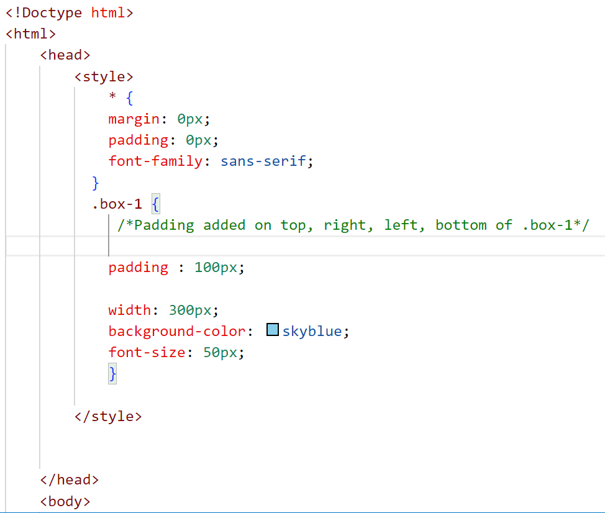
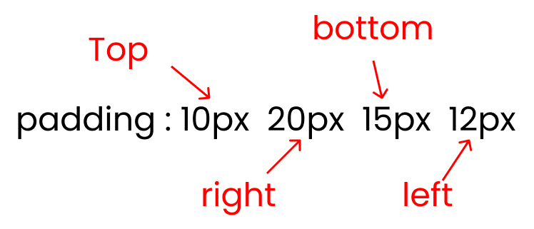
The Padding Property
The CSS padding properties are used to generate space around an element's content, inside of any defined borders.
How to use the padding property in CSS
This is the shorthand of the four padding properties:
padding-top
padding-right
padding-bottom
padding-left
CODE:
Syntax:
Notes:
The Padding Property
The CSS padding properties are used to generate space around an element's content, inside of any defined borders.
With CSS, you have full control over the padding. There are properties for setting the padding for each side of an element (top, right, bottom, and left).
How to use the padding property in CSS
This is the shorthand of the four padding properties:
padding-top
padding-right
padding-bottom
padding-left

Slide 52
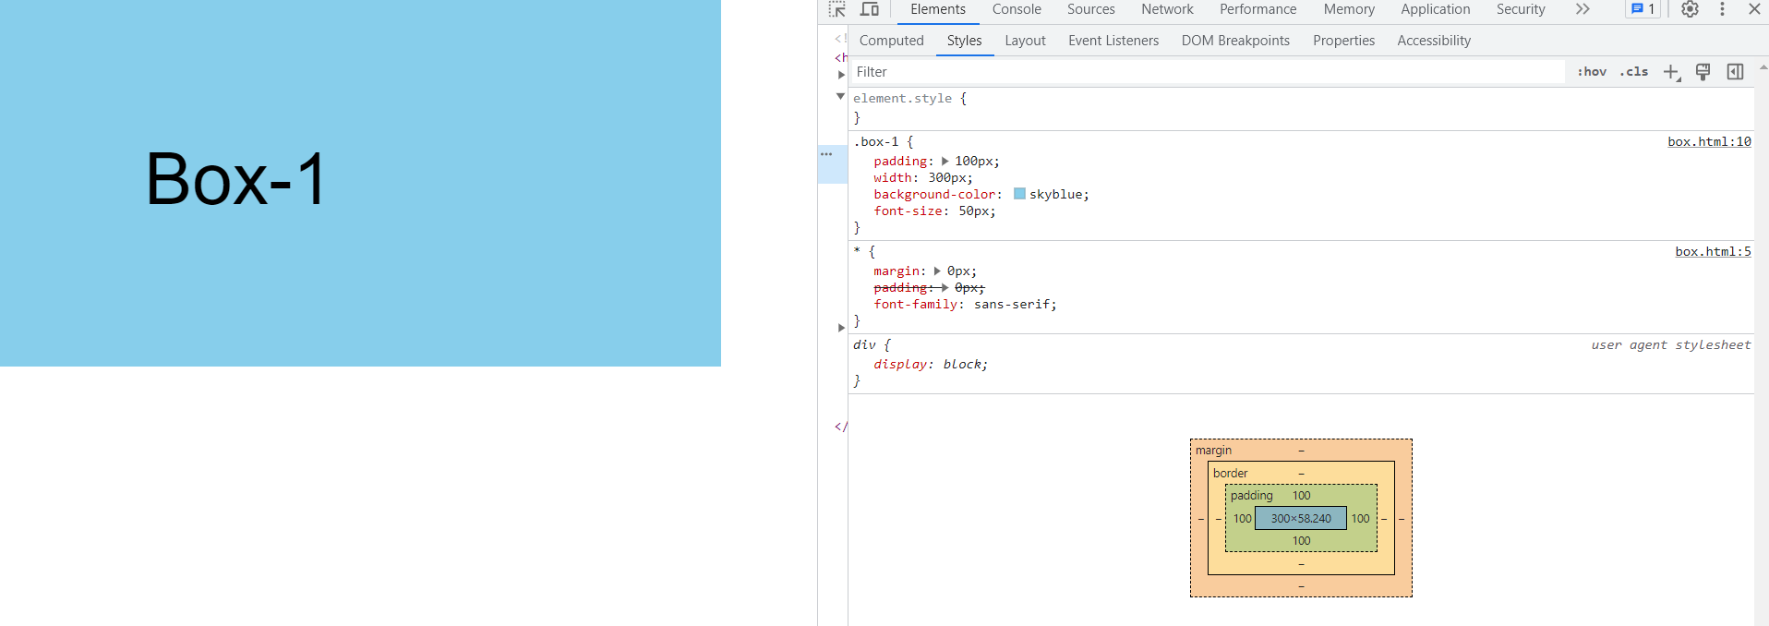
Output:
Let's add some padding to our content.
// Padding added on top, right, left, bottom of .box-1.box-1{ padding : 100px;}
Padding:100px
Notes:
Output:
Let's add some padding to our content.
// Padding added on top, right, left, bottom of .box-1.box-1{ padding : 100px;}

Slide 53
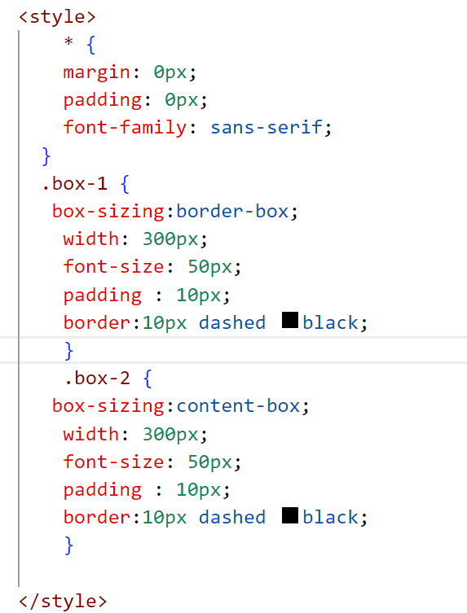
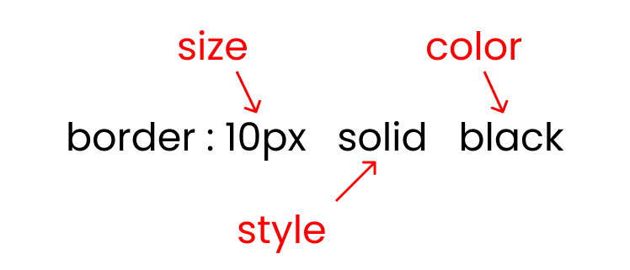
The Border Property
The CSS border properties allow you to specify the style, width, and color of an element's border.
How to use the border property in CSS
the border is the space added on top of our main content + padding
There are three crucial inputs of the border property:
border size
border style : solid / dotted/ dashed
border color
CODE:
Syntax:
Notes:
The Border Property
The CSS border properties allow you to specify the style, width, and color of an element's border.
How to use the border property in CSS
the border is the space added on top of our main content + padding
There are three crucial inputs of the border property:
border size
border style : solid / dotted/ dashed
border color

Slide 54
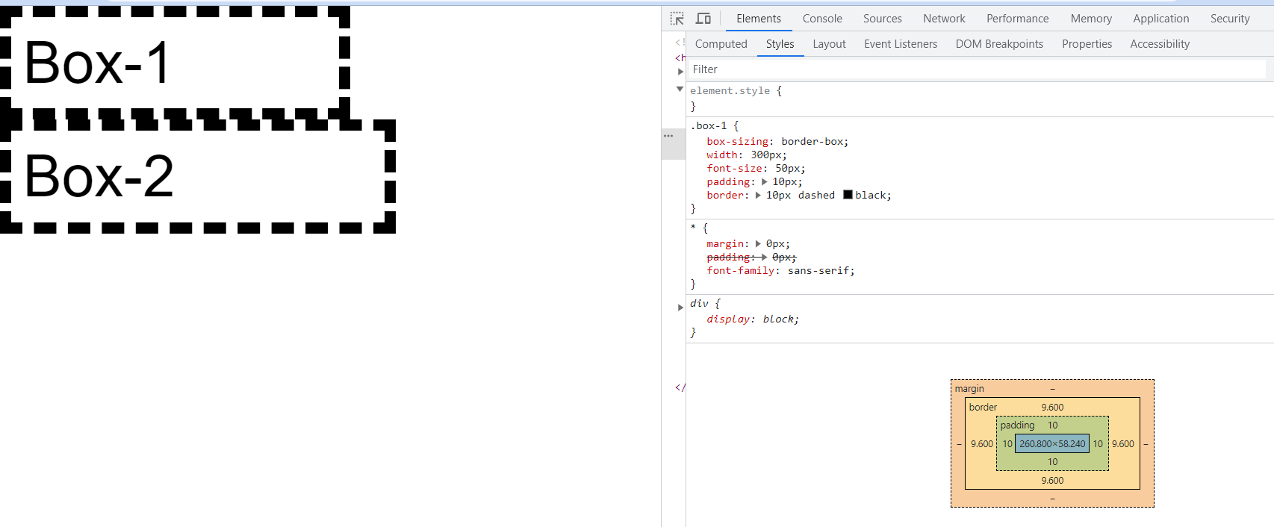
Output:
Write this code in your CSS,
.box-1 { width: 300px; font-size: 50px; padding: 50px; border: 10px dashed black;}
Notes:
Output:
Write this code in your CSS,
.box-1 { width: 300px; font-size: 50px; padding: 50px; border: 10px dashed black;}
OUTPUT

Slide 55
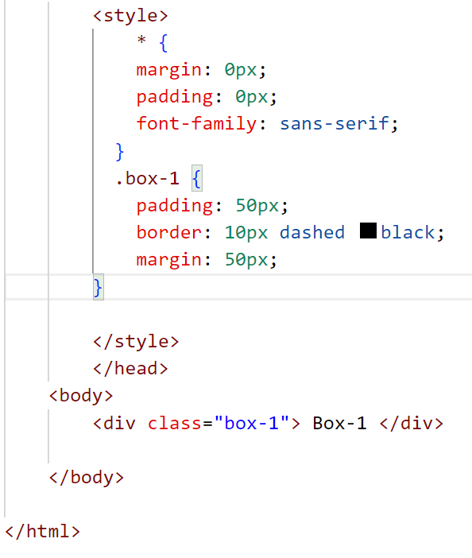
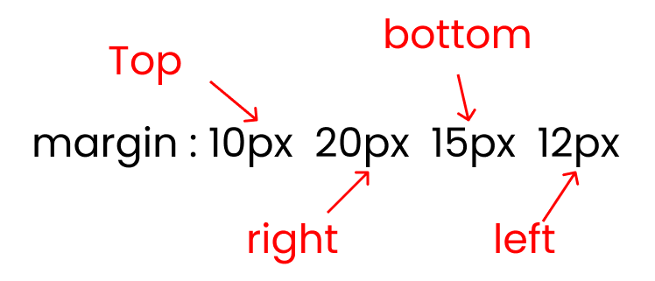
The Margin Property
The CSS margin properties are used to create space around elements, outside of any defined borders.
How to use margin property in CSS
This is the shorthand for the four properties of the margin property:
margin-top
margin-right
margin-bottom
margin-left
CODE:
Syntax:
Notes:
The Margin Property
The CSS margin properties are used to create space around elements, outside of any defined borders.
How to use margin property in CSS
This is the shorthand for the four properties of the margin property:
margin-top
margin-right
margin-bottom
margin-left

Slide 56
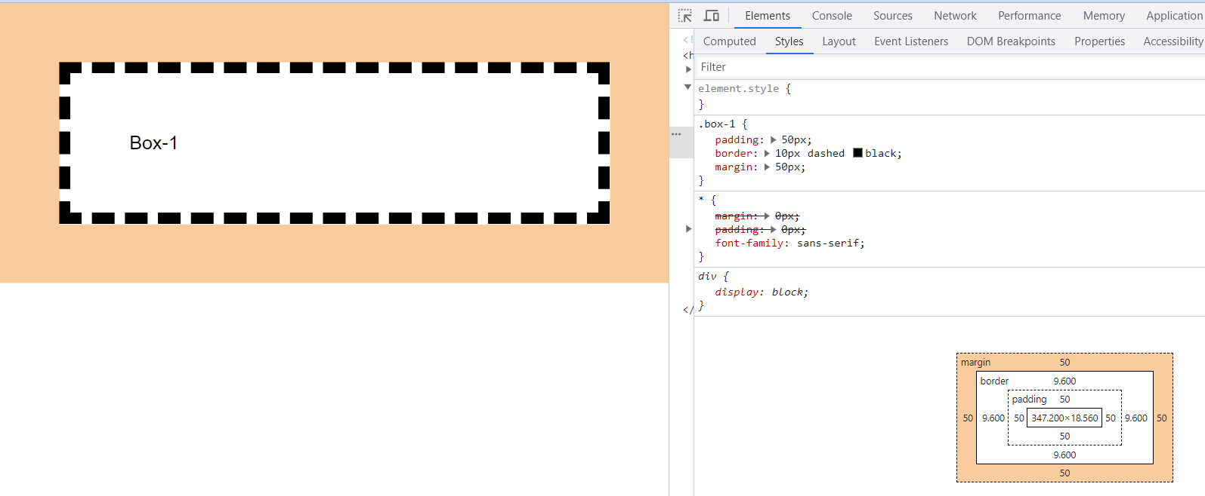
Output:
.box-1 { padding: 50px; border: 10px dashed black; margin: 50px;}
Notes:
Output:
box-1 { padding: 50px; border: 10px dashed black; margin: 50px;}

Slide 57
Lab 17: Use of Box Model on HTML Element
Notes:
Trainer will switch the window to the Visual Studio code and performs the hand-on classroom exercise.

Slide 58
What Is JavaScript?
JavaScript is a scripting language for creating dynamic web page content.
It creates elements for improving site visitors’ interaction with web pages, such as dropdown menus, animated graphics, and dynamic background colors.
How does JavaScript work?
JavaScript is what is known as a client-side script. Most Web applications, such as a search engine, work because of an interaction between the user's device (e.g. computer, phone, or tablet) and a remote server.
The software on the remote server sends information to the client (i.e. the user's machine) and the software on the client side reads the information and renders a Web page on screen.
Notes:
Trainer can simply give the exam of form validation to understand the JS concepts. Just pass a question to students: Once you get into the signup form, after giving information what would be the next step? After receiving an answer, can inform the student about submit option.
------------------------------------------------------------------------------------------
What Is JavaScript?
JavaScript is a scripting language for creating dynamic web page content.
It creates elements for improving site visitors’ interaction with web pages, such as dropdown menus, animated graphics, and dynamic background colors.
How does JavaScript work?
JavaScript is what is known as a client-side script. Most Web applications, such as a search engine, work because of an interaction between the user's device (e.g. computer, phone, or tablet) and a remote server.
The software on the remote server sends information to the client (i.e. the user's machine) and the software on the client side reads the information and renders a Web page on screen.

Slide 59
Realtime Example:
Take a search engine for example.
Today, search engines almost all have an autocomplete function.
The user begins typing a word into the search box and a list of possible search terms or phrases appears below. The experience is seamless.
Suggested search terms appear without reloading the page.
In the background, JavaScript reads the letters as the user types, sends those letters to a remote server and the server sends suggestions back.
The software on the server side analyses the words and runs algorithms to anticipate the user's search term.
The JavaScript on the client's machine is as simple and small as possible so as not to slow down the user's interaction.
Notes:
Welcome students with some Real-time scenarios of how this JavaScript used in different sectors
-------------------------------------------------------------------------
Realtime Example
Take a search engine for example.
Today, search engines almost all have an autocomplete function.
The user begins typing a word into the search box and a list of possible search terms or phrases appears below. The experience is seamless.
Suggested search terms appear without reloading the page.
In the background, JavaScript reads the letters as the user types, sends those letters to a remote server and the server sends suggestions back.
The software on the server side analyses the words and runs algorithms to anticipate the user's search term.
The JavaScript on the client's machine is as simple and small as possible so as not to slow down the user's interaction.

Slide 60
How to use JavaScript in HTML
Inline JavaScript
<button onclick="alert('You just clicked a button')">Click me!</button>
This is an example of inline JavaScript.
The value of onclick can be some Match calculation, a dynamic addition to the DOM – any syntax-valid JavaScript code.
Internal JavaScript
The style tag for style declarations within an HTML page, the script tag exists for JavaScript.
<script> function(){ alert("I am inside a script tag")}</script>
External JavaScript
<!-- index.html --><script src="./script.js">
</script>// script.jsalert("I am inside an external file");
Notes:
Put a question to a student, how we will insert or embed the CSS in HTML? Once we get a reply, explain to them how the insertion of JS code in HTML.
------------------------------------------------------------------------
How to Use JavaScript in HTML
Inline JavaScript
<button onclick="alert('You just clicked a button')">Click me!</button>
This is an example of inline JavaScript.
The value of onclick can be some Match calculation, a dynamic addition to the DOM – any syntax-valid JavaScript code.
Internal JavaScript
The style tag for style declarations within an HTML page, the script tag exists for JavaScript.
<script> function(){ alert("I am inside a script tag") }</script>
External JavaScript
<!-- index.html --><script src="./script.js">
</script>// script.jsalert("I am inside an external file");

Slide 61
Lab 18: Different ways to apply Javascript on
HTML Page
Notes:
Trainer will switch the window to the Visual Studio code and performs the hand-on classroom exercise.

Slide 62
JS Events
An event is a signal that something has happened. All DOM nodes generate such signals (but events are not limited to DOM).
Here’s a list of the most useful DOM events, just to take a look at Mouse events:
click – when the mouse clicks on an element (touchscreen devices generate it on a tap).
contextmenu – when the mouse right-clicks on an element.
mouseover / mouseout – when the mouse cursor comes over / leaves an element.
mousedown / mouseup – when the mouse button is pressed / released over an element.
mousemove – when the mouse is moved.
Notes:
Other main use-case of JS is to handle the events. Trainer needs to explain the various events and working of event handling
----------------------------------------------------------
JS Events
An event is a signal that something has happened. All DOM nodes generate such signals (but events are not limited to DOM).Here’s a list of the most useful DOM events, just to take a look at: Mouse events:
click – when the mouse clicks on an element (touchscreen devices generate it on a tap).
contextmenu – when the mouse right-clicks on an element.
mouseover / mouseout – when the mouse cursor comes over / leaves an element.
mousedown / mouseup – when the mouse button is pressed / released over an element.
mousemove – when the mouse is moved.

Slide 63
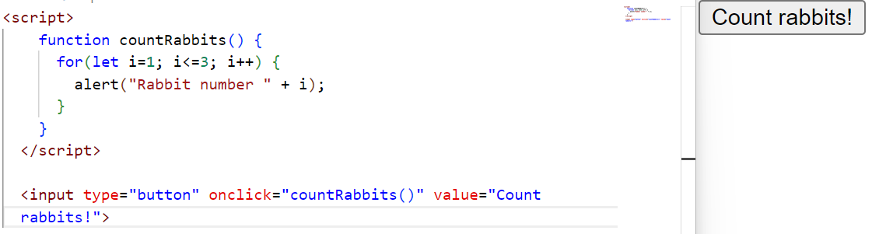
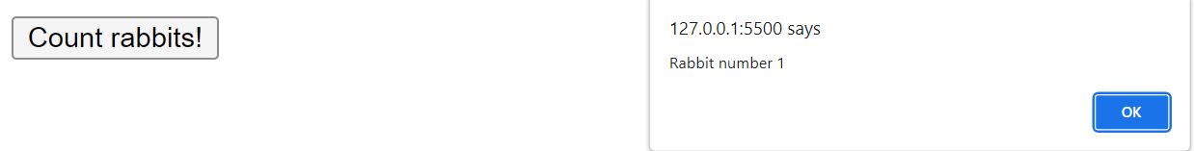
Keyboard Events
Keydown and Keyup - when a keyboard key is pressed and released.
Form Element Events:
Submit - when the visitor submits a <form>.
Focus - when the visitor focuses on an element, e.g. on an <input>.
Document Events:
DOMContentLoaded – when the HTML is loaded and processed, DOM is fully built.
Notes:
Keyboard events:
keydown and keyup – when a keyboard key is pressed and released.
Form element events:
submit – when the visitor submits a <form>.
focus – when the visitor focuses on an element, e.g. on an <input>.
Document events:
DOMContentLoaded – when the HTML is loaded and processed, DOM is fully built.

Slide 64
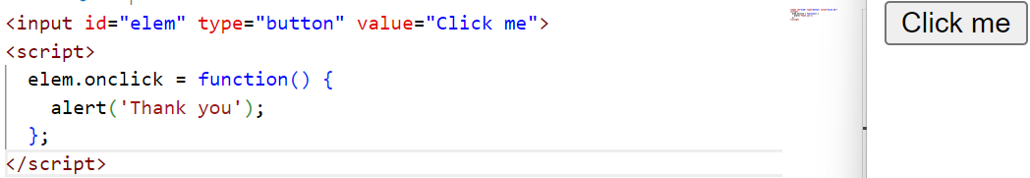
DOM Property
We can assign a handler using a DOM property on<event>.
For instance, elem.onclick:
Notes:
DOM Property
We can assign a handler using a DOM property on<event>.
For instance, elem.onclick:

Slide 65
AddEventListener
The syntax to add a handler:
element.addEventListener(event, handler, [options]);
event
Event name, e.g. "click".
handler
The handler function.
Options
An additional optional object with properties:
Once: if true, then the listener is automatically removed after it triggers.
Capture the phase where to handle the event, to be covered later in the chapter Bubbling and capturing. For historical reasons, options can also be false/true, that’s the same as {capture: false/true}.
Passive: if true, then the handler will not call preventDefault()
Notes:
AddEventListener
The syntax to add a handler:
element.addEventListener(event, handler, [options]);
event
Event name, e.g. "click".
handler
The handler function.
options
An additional optional object with properties:
once: if true, then the listener is automatically removed after it triggers.
capture: the phase where to handle the event, to be covered later in the chapter Bubbling and capturing. For historical reasons, options can also be false/true, that’s the same as {capture: false/true}.
passive: if true, then the handler will not call preventDefault()

Slide 66
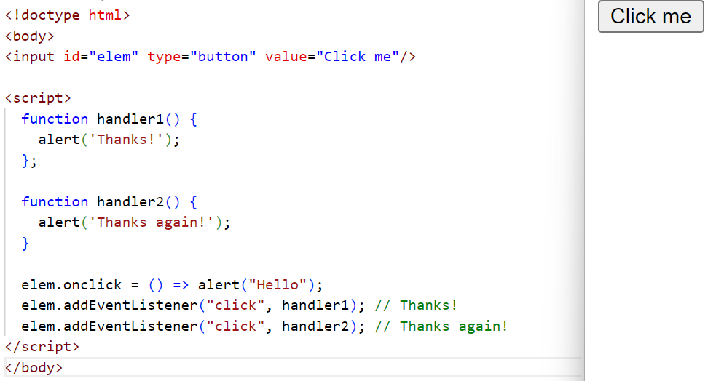
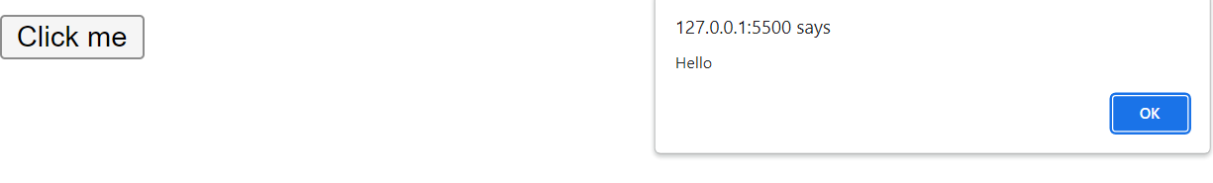
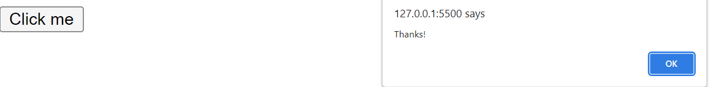
Code & Output
Notes:
Code and Output

Slide 67
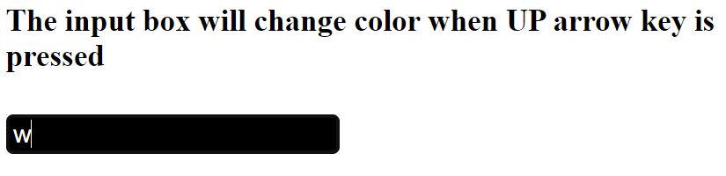
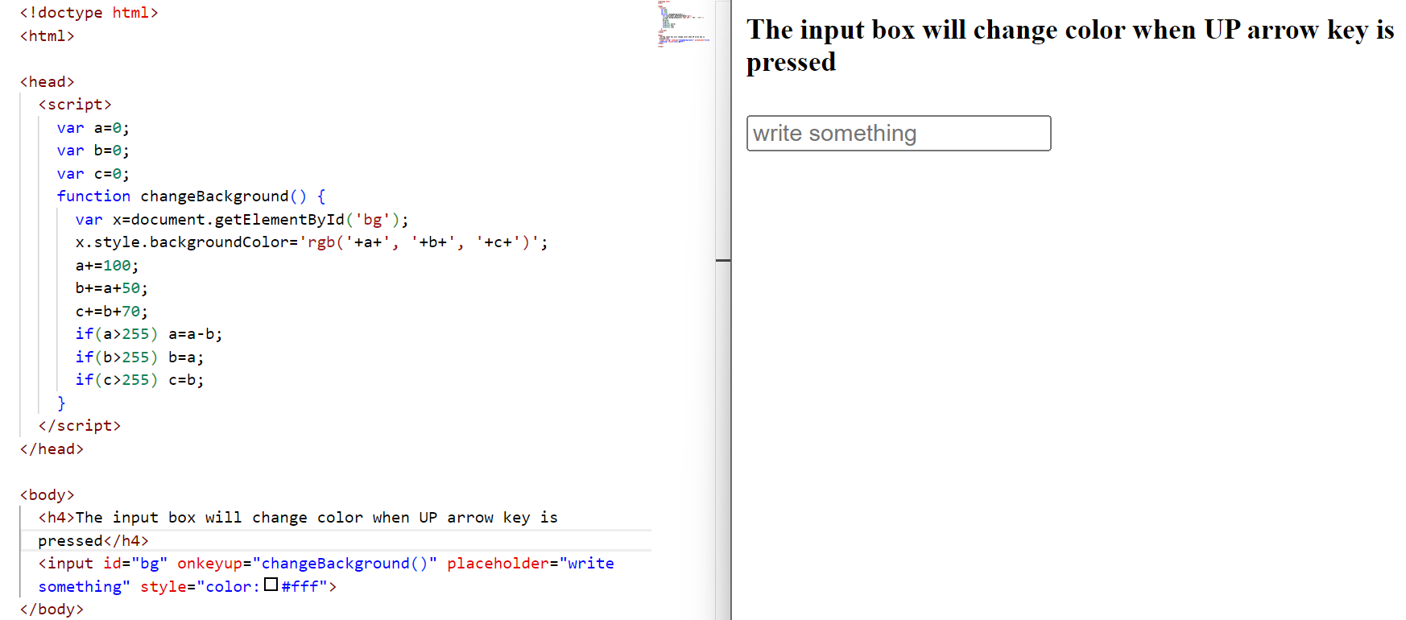
Javascript Onkeyup Event:
This event is a keyboard event and executes instructions whenever a key is released after pressing. Example: In this example, we will change the color by pressing UP arrow key
Notes:
JavaScript onkeyup event: This event is a keyboard event and executes instructions whenever a key is released after pressing. Example: In this example, we will change the color by pressing UP arrow key

Slide 68
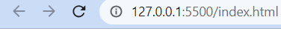

Onmouseover Event:
This event corresponds to hovering the mouse pointer over the element and its children, to which it is bound to. Example: In this example, we will make the box vanish when the mouse will be hovered on it
Notes:
onmouseover event: This event corresponds to hovering the mouse pointer over the element and its children, to which it is bound to. Example: In this example, we will make the box vanish when the mouse will be hovered on it

Slide 69


Onchange Event
This event detects the change in value of any element listing to this event. Example:
Notes:
onchange event: This event detects the change in value of any element listing to this event.

Slide 70


Onfocus Event
An element listing to this event executes instructions whenever it receives focus.
Notes:
onfocus event: An element listing to this event executes instructions whenever it receives focus.

Slide 71
Lab 19: How to Handle Events on JavaScript (Click, Double Click, MouseOver, MouseOut, OnLoad, OnChange)
Notes:
Trainer will switch the window to the Visual Studio code and performs the hand-on classroom exercise.

Slide 72
JavaScript Animations
JavaScript animations can handle things that CSS can’t.
For instance, moving along a complex path, with a timing function different from Bezier curves, or an animation on a canvas.
Using SetInterval
An animation can be implemented as a sequence of frames – usually small changes to HTML/CSS properties.
For instance, changing style.left from 0px to 100px moves the element.
And if we increase it in setInterval, changing by 2px with a tiny delay, like 50 times per second, then it looks smooth.
That’s the same principle as in the cinema: 24 frames per second is enough to make it look smooth.
Notes:
Another use-case of JS is to add on animations on html elements.. For modern designing this property is used.
----------------------------------------------------
JavaScript Animations
JavaScript animations can handle things that CSS can’t.For instance, moving along a complex path, with a timing function different from Bezier curves, or an animation on a canvas.Using setInterval
An animation can be implemented as a sequence of frames – usually small changes to HTML/CSS properties.
For instance, changing style.left from 0px to 100px moves the element. And if we increase it in setInterval, changing by 2px with a tiny delay, like 50 times per second, then it looks smooth.
That’s the same principle as in the cinema: 24 frames per second is enough to make it look smooth.

Slide 73


Code And Output
Notes:
Code And Output

Slide 74
Lab 20: How to apply Animation using JavaScript
Notes:
Trainer will switch the window to the Visual Studio code and performs the hand-on classroom exercise.

Slide 75
What are Cookies?
A cookie is a piece of data that is stored on your computer to be accessed by your browser.
Why do you need a Cookie?
The communication between a web browser and a server happens using a stateless protocol named HTTP.
The stateless protocol treats each request independently.
So, the server does not keep the data after sending it to the browser.
But in many situations, the data will be required again. Here come cookies into a picture.
With cookies, the web browser will not have to communicate with the server each time the data is required.
Instead, it can be fetched directly from the computer.
JavaScript Set CookieThe trainer
You can create cookies using a document. cookie property like this.
document.cookie = "cookiename=cookievalue"
Notes:
Cookies and sessions are most important topic of JS. Trainer needs to explain the difference between cookies and session. Explain the topics using real time examples.
----------------------------------------------------------------------
What are Cookies?
A cookie is a piece of data that is stored on your computer to be accessed by your browser.
Why do you need a Cookie?
The communication between a web browser and server happens using a stateless protocol named HTTP. Stateless protocol treats each request independent. So, the server does not keep the data after sending it to the browser. But in many situations, the data will be required again. Here come cookies into a picture. With cookies, the web browser will not have to communicate with the server each time the data is required. Instead, it can be fetched directly from the computer.
Javascript Set Cookie
You can create cookies using document. cookie property like this.
document.cookie = "cookiename=cookievalue"

Slide 76




Code And Output
Notes:
CODE AND OUTPUT

Slide 77
Session
The sessionStorage object stores data only for a session.
It means that the data stored in the sessionStorage will be deleted when the browser is closed.
A page session lasts as long as the web browser is open and survives over the page refresh.
When you open a page in a new tab or window, the web browser creates a new session.
If you open multiple tabs or windows with the same URL, the web browser creates a separate sessionStorage for each tab or window.
So data stored in one web browser tab cannot be accessible in another tab.
When you close a tab or window, the web browser ends the session and clears data in the sessionStorage.
Notes:
Session
The sessionStorage object stores data only for a session. It means that the data stored in the sessionStorage will be deleted when the browser is closed.
A page session lasts as long as the web browser is open and survives over the page refresh.
When you open a page in a new tab or window, the web browser creates a new session.
If you open multiple tabs or windows with the same URL, the web browser creates a separate sessionStorage for each tab or window. So data stored in one web browser tab cannot be accessible in another tab.
When you close a tab or window, the web browser ends the session and clears data in the sessionStorage.

Slide 78


Code and Output
Notes:
Code and Output

Slide 79
Lab 21: Session and Cookie Management using JavaScript
Notes:
Trainer will switch the window to the Visual Studio code and performs the hand-on classroom exercise.

Slide 80

Summary
Understood about Model parameters and Hyperparameters, and
Hyperparameter optimization using Grid Search & Random Search
Notes:
In this PPT, we have learned about,
Know Model parameters and hyperparameters? and
Hyperparameter optimization using Grid Search & Random Search
Let's have a look at other concepts.

Slide 81

Quiz
1. Which of the following is an example of a dimensionality reduction technique?
Principal component analysis (PCA)
Support vector machine (SVM)
K-nearest neighbors (KNN)
AdaBoost
Answer: a
Principal component analysis (PCA)

Slide 82
Thank you!
Notes:
82

